Slide 1
Capstone project - Walmart
01/02/2017 – Review of initial data analysis
Is my data analysis in right direction
Are my next steps helping me to get conclusion
Is my code optimum

Slide 2
Content
Recap from last review of 12/28/2016
Summary of progress by 01/02/2017
Next steps
Data Analysis
Discovery of of stores selling maximum units and discovery of items selling in most stores
Review of items sold in most stores
Review of stores with maximum unique items across items
Review of highest selling items across stores
Review of each item across

Slide 3
Recap – 12/28/2016
We do not have enough variable to do clustering. Let’s look into data
Check if number of records are right in training and weather
Joined data –
Training (date from 2012-01-01 t 2014-10-31, 45 store, 111 items and unit sales)
Key (45 stores to 20 weather stations)
Weather (date, weather station, weather variables)
Analyzed
Training (date from 2012-01-01 t 2014-10-31, 45 store, 111 items and unit sales)
Recommendation
We should cluster stores first and then do regression for each cluster.
Try to avoid the warning message
Try stats in ggplot to get average line

Slide 4
Recap – 12/28/2016
Am I in the right direction or going all the way in a different direction
Function to find week#, weekday and weekend
Function to find holidays
What other factors may be impacting sales
Fuel price
Un-employment
Should I divide training data into training and validation – 50/50 or k-node/mode
Further analysis
Apply Is_Holiday to date
Divide time series in week
Add two columns – weekday and weekend
Review sales by weekday, weekend and super impose holiday week
Cluster stores
Check lubridate for data functions

Slide 5
Summary – 01/02/2017
I have taken train file of Walmart (45 stores, 111 items, sales unit for each day from 2012-01-01 to 2014-10-31)
Created new variables
IsMonToThu - 1 if sold from Mon to Thu, 0 for Fri to Sun
HolidayShopping - 1 if sold within 10 days of holiday/festival
Data Analysis
Fix item 5 and 93
Keep an eye on item 45
Item # 6,8,9,15, 16,23,25,28….,44,… have huge deviations, but are not outliers. There could be some other driver of lift for them
No impact of holidays or weekday/weekend on sales of these 111 items
Code and docs for review - https://github.com/ResearchBigD/Springboard_Foundataion_DataScience/tree/master/Capstone_Walmart

Slide 6
Next steps – 01/02/2017
1 – If leading average of sold qty for last 7 days is greater than 1 and qty of today is 0 and trailing average of 7 days is greater than 1, item is stock-out
2 – Should I take 50%of training data for model and 50% for validation
Identify stock-outs
Compare weekly sales for 2012, 2013 and 2014 for weekday/weekend
Sales data does not indicate any clustering of stores or items -> Review weather data for station and see if it points to different weather patterns -> If yes, join training and weather data; and cluster stores according to weather
Run regression to predict sales for weather

Slide 7
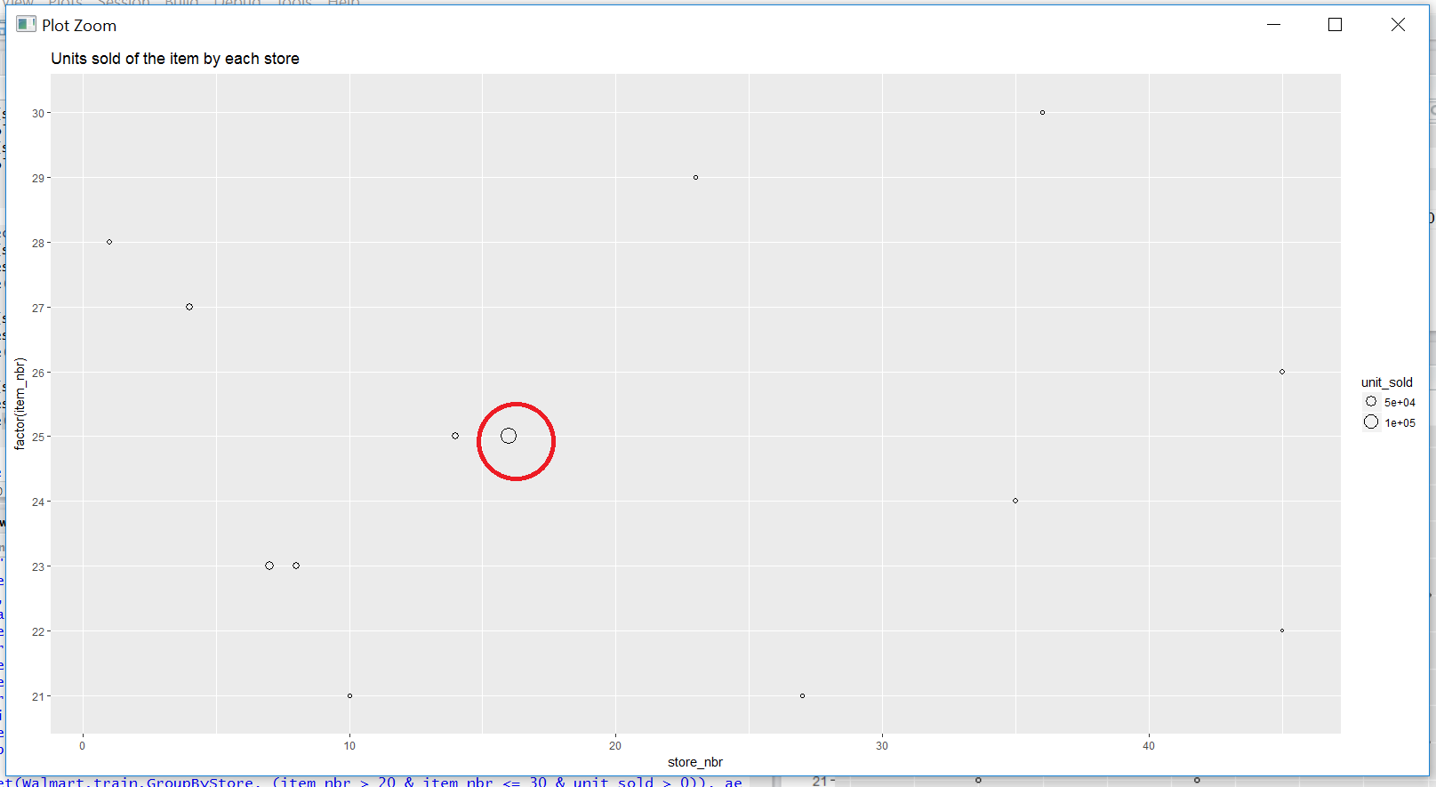
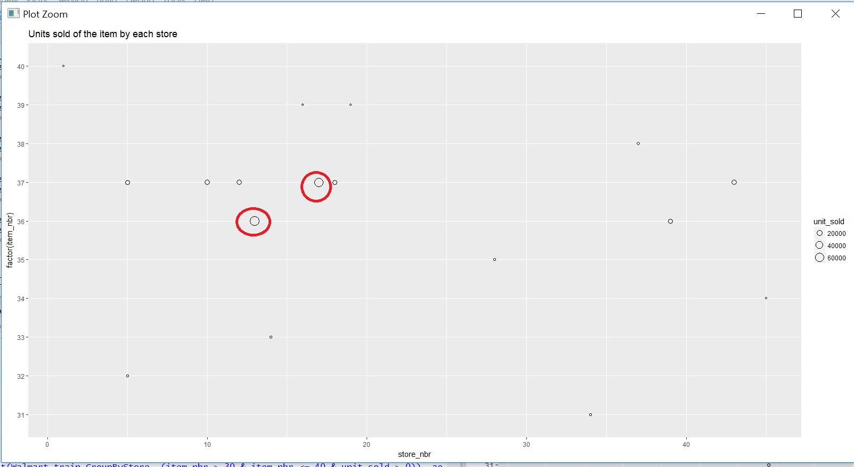
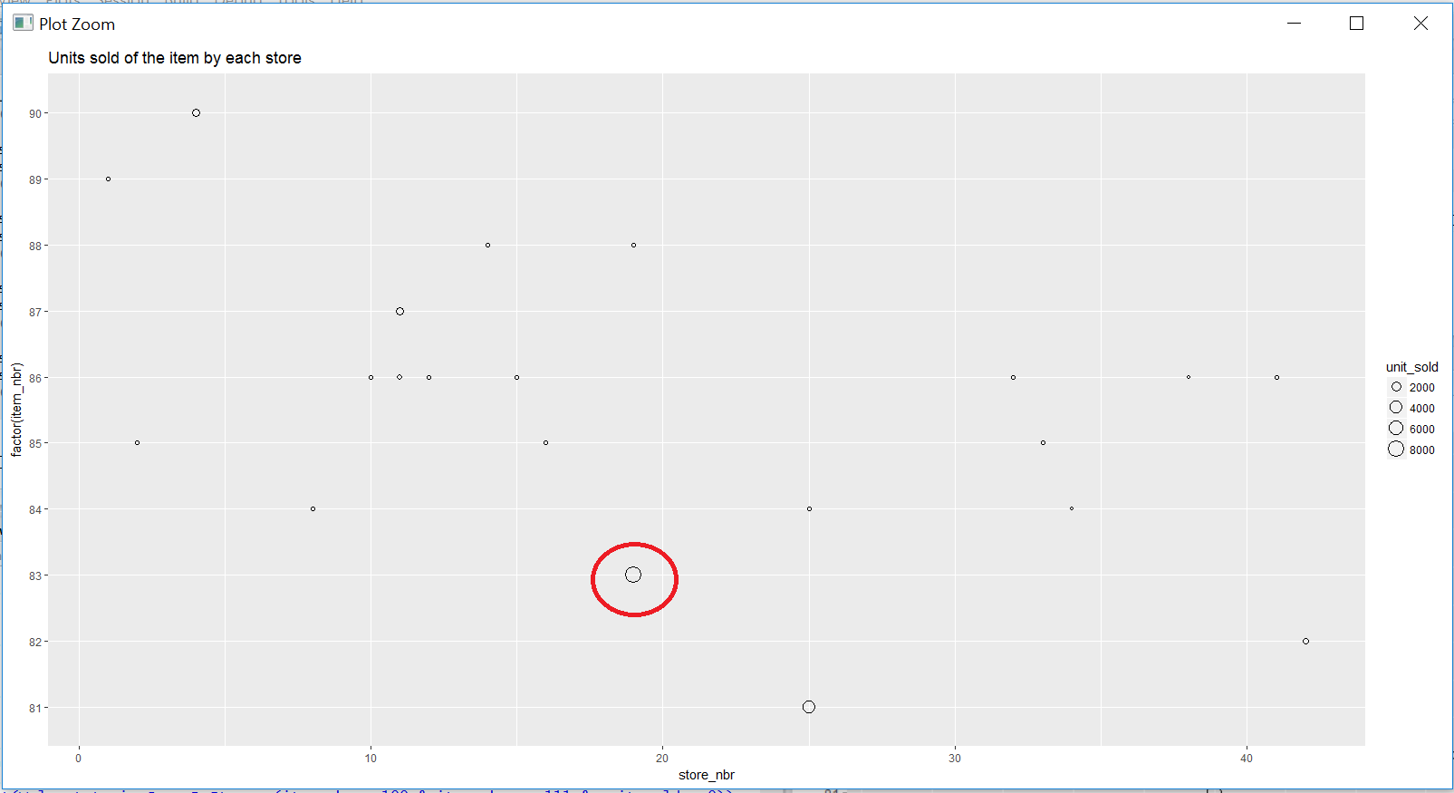
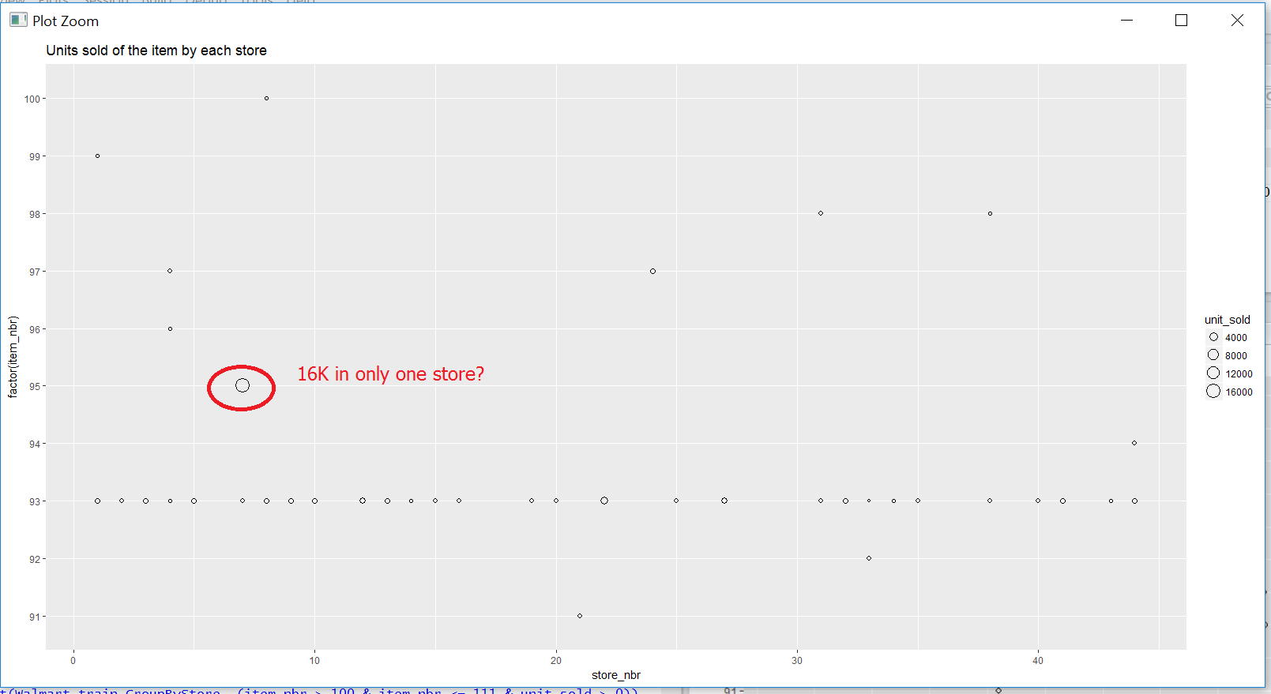
Review of stores for total units
Nothing conclusive

Slide 8
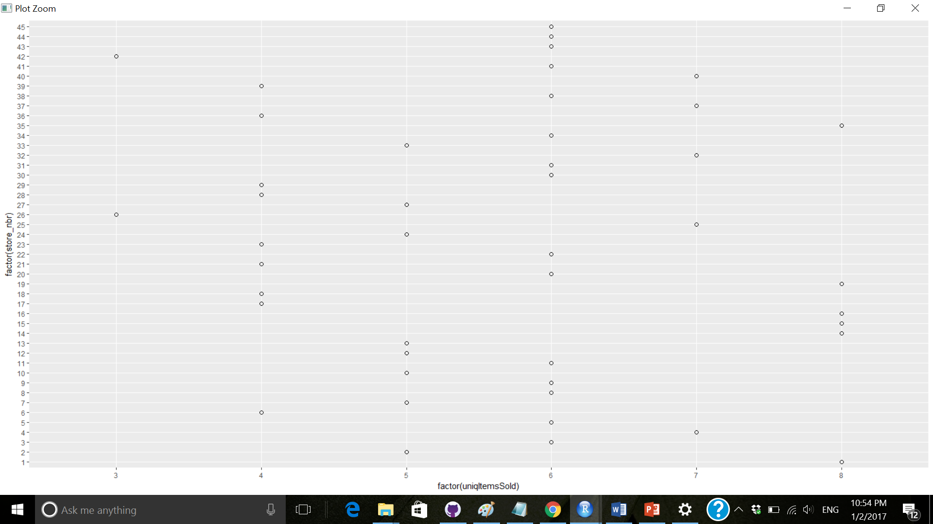
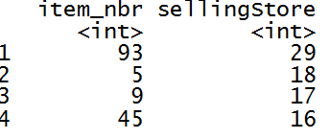
Which items are being sold in most stores
1 – 8 items are the most being sold by store, 6 is the median
2 – 93 is the item being sold in the max store – 29
Recommendation - Review top 4 items, which are sold in most stores

Slide 9
Review of items sold in most stores

Slide 10
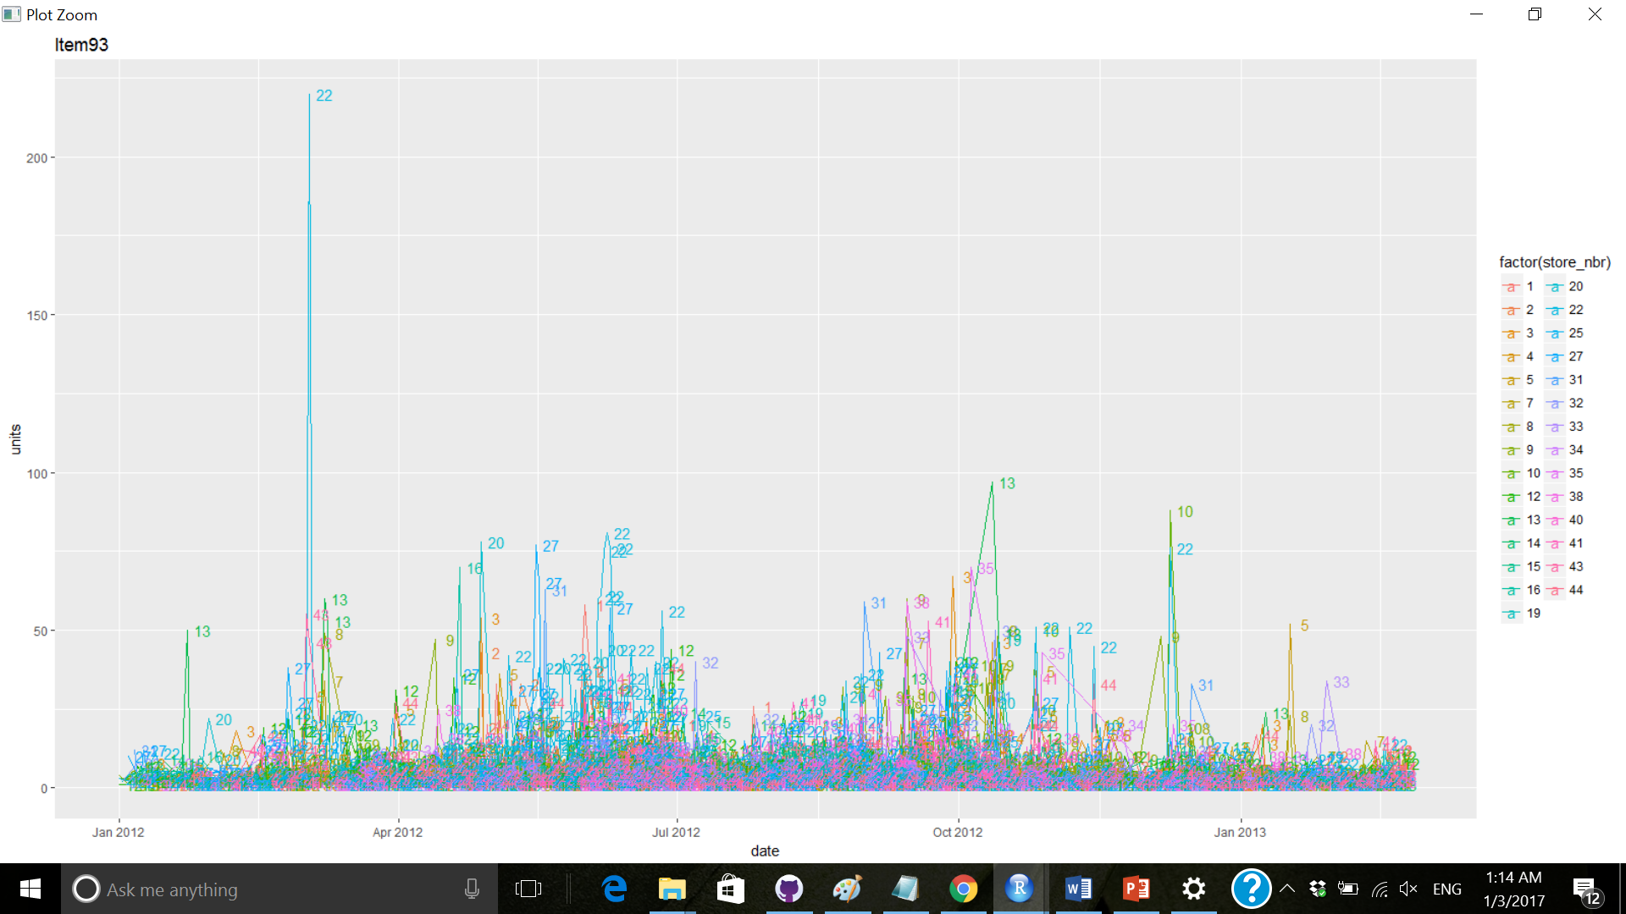
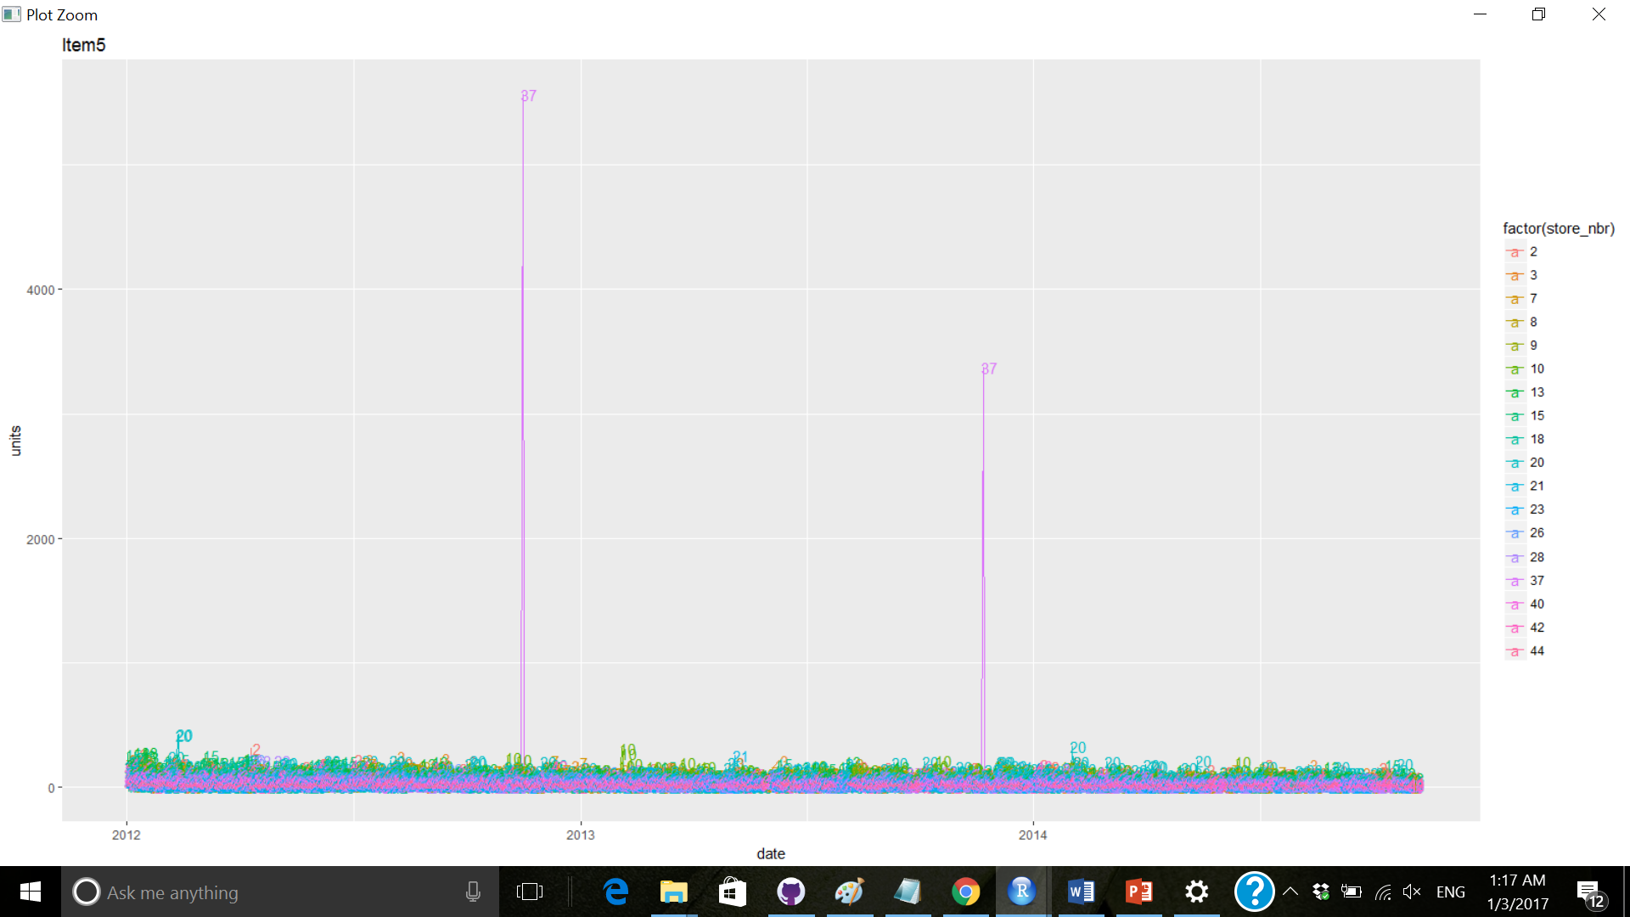
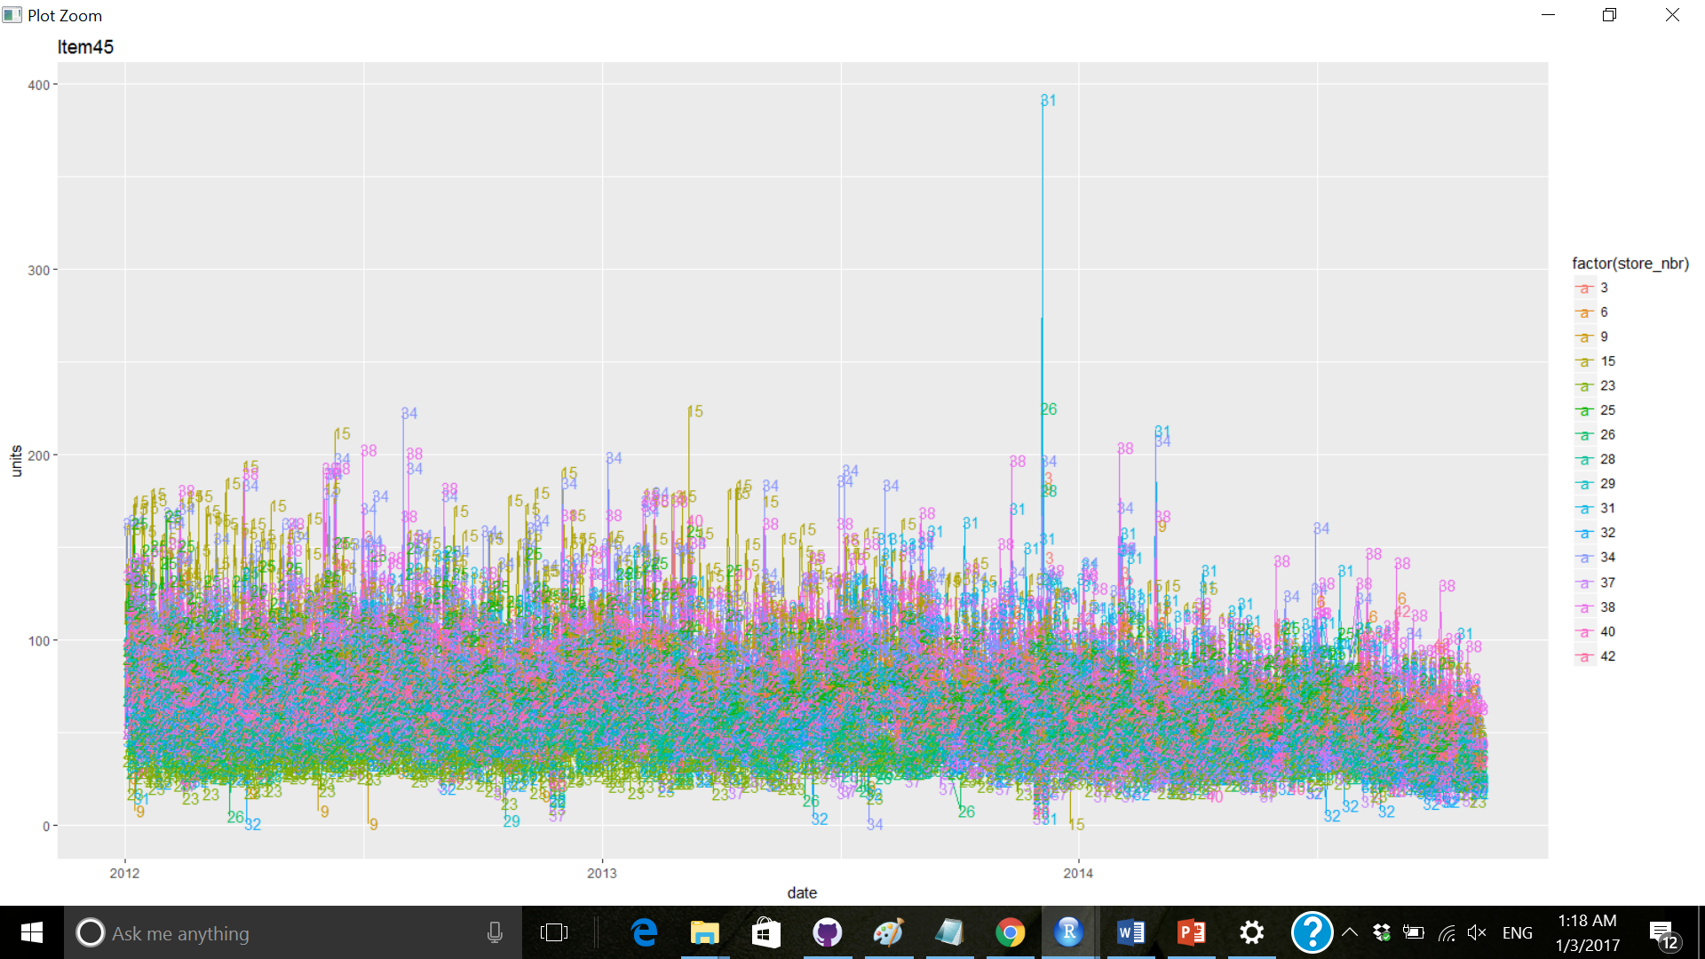
Review items, sold in most stores
1 – Item 93 is too high in store # 22
2 – Item 5 is too high in store # 37
3 – Item 45 is too high in store # 31
Review these stores

Slide 11
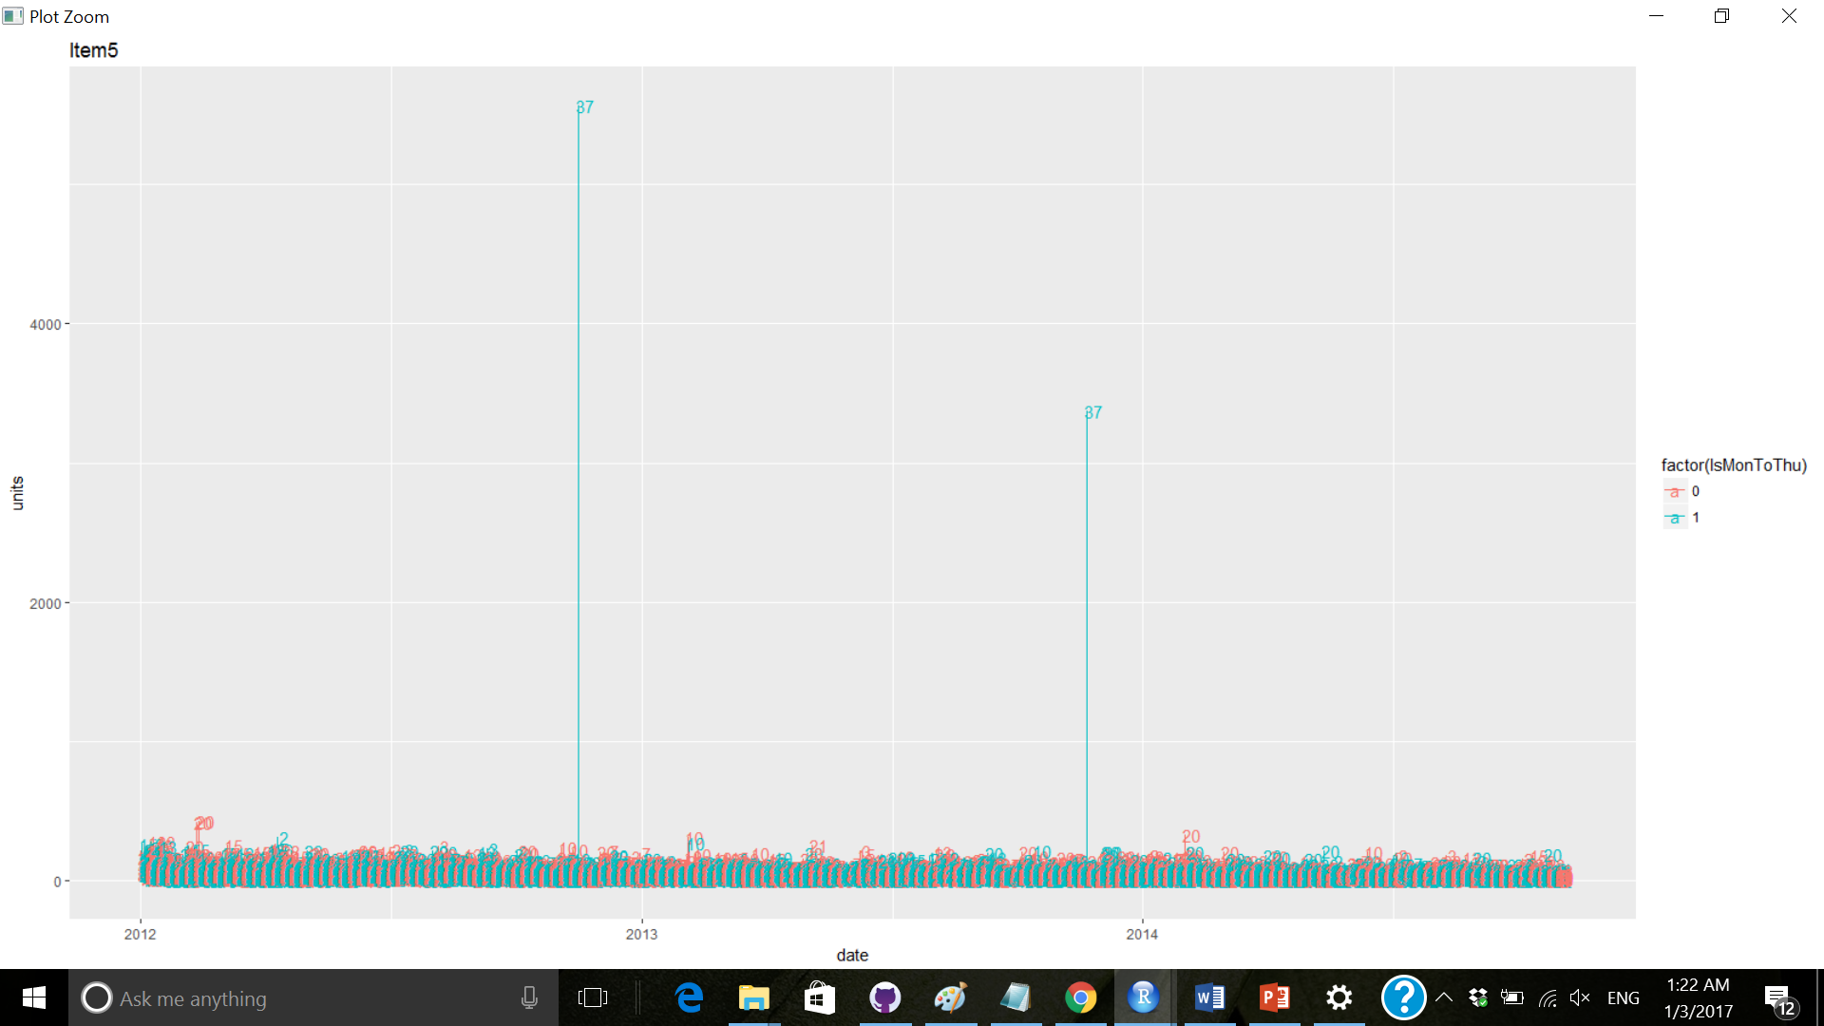
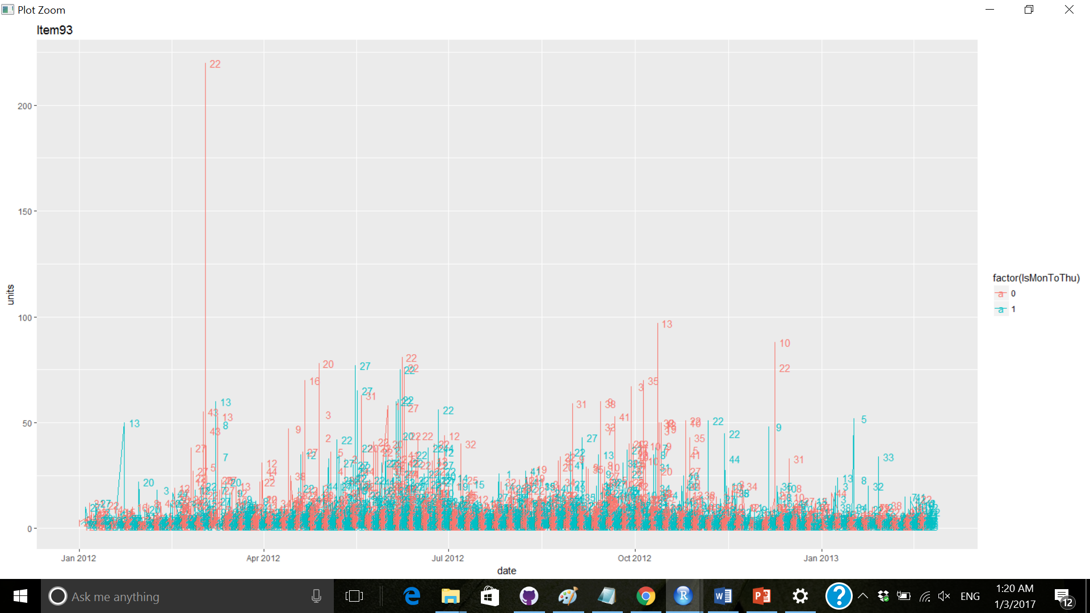
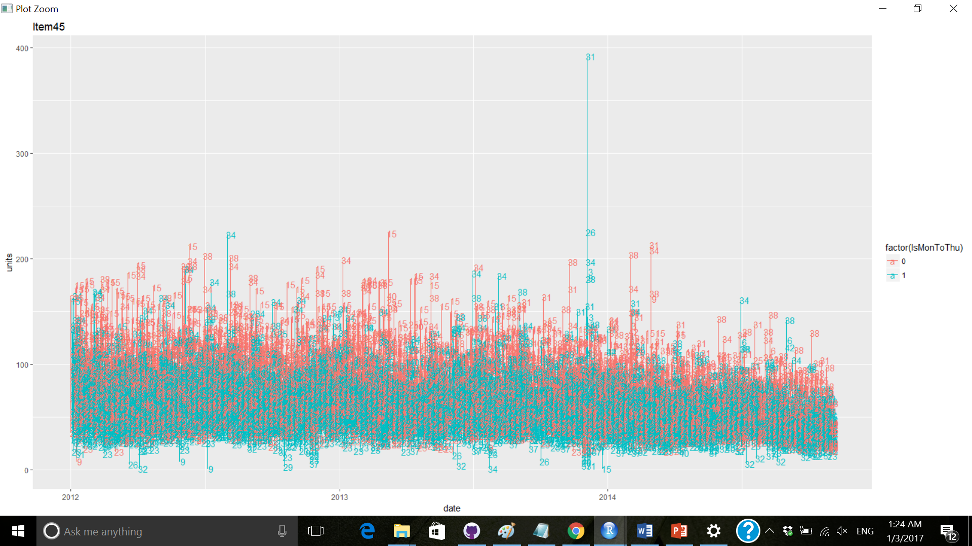
Is there a pattern in weekday/weekend sales
Weekend has higher sales
No more insights

Slide 12
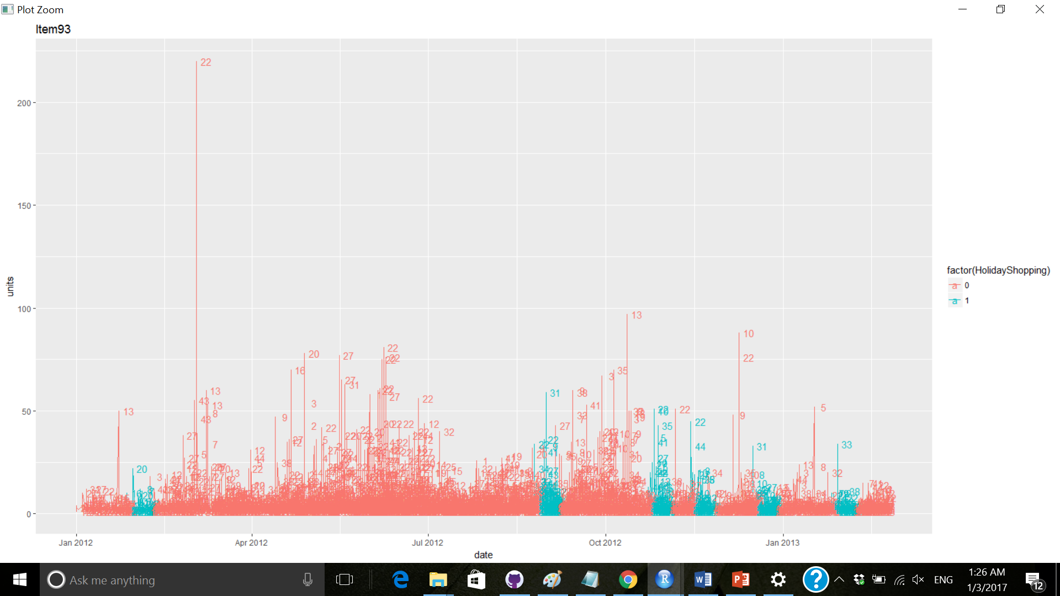
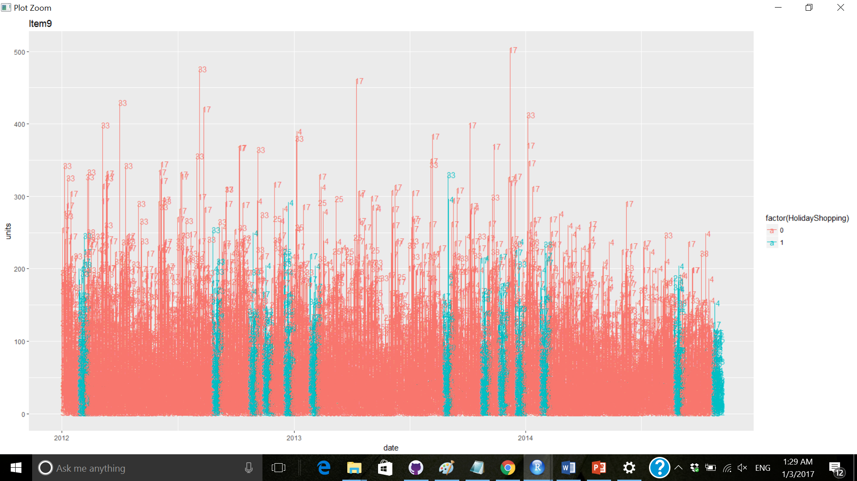
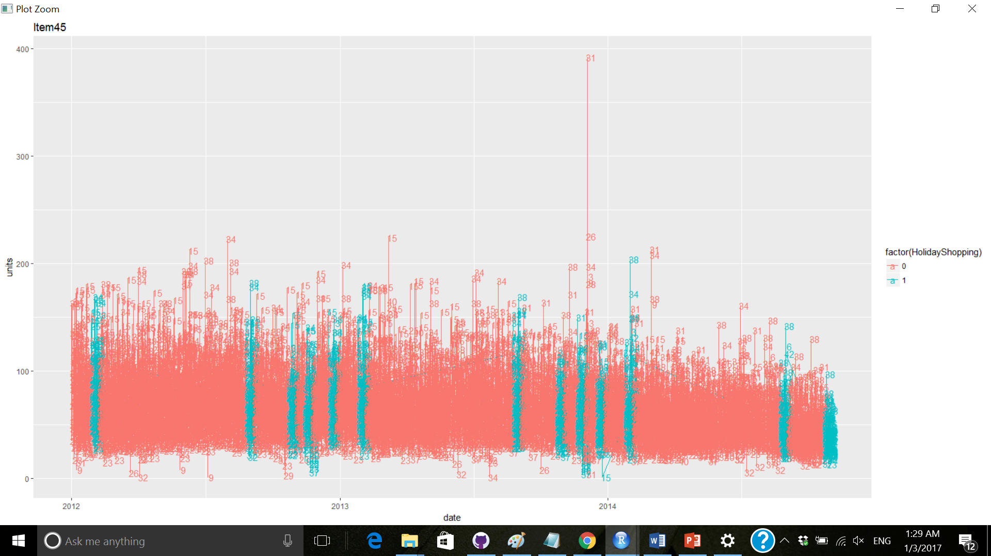
Do holidays impact sales
No noticeable impact

Slide 13
Review of Stores with highest number of unique items

Slide 14
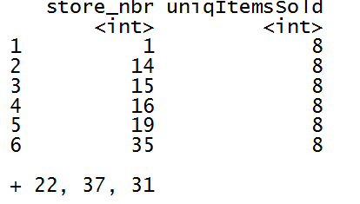
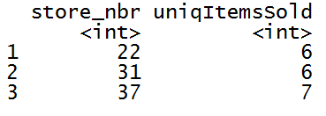
Which stores?

Slide 15
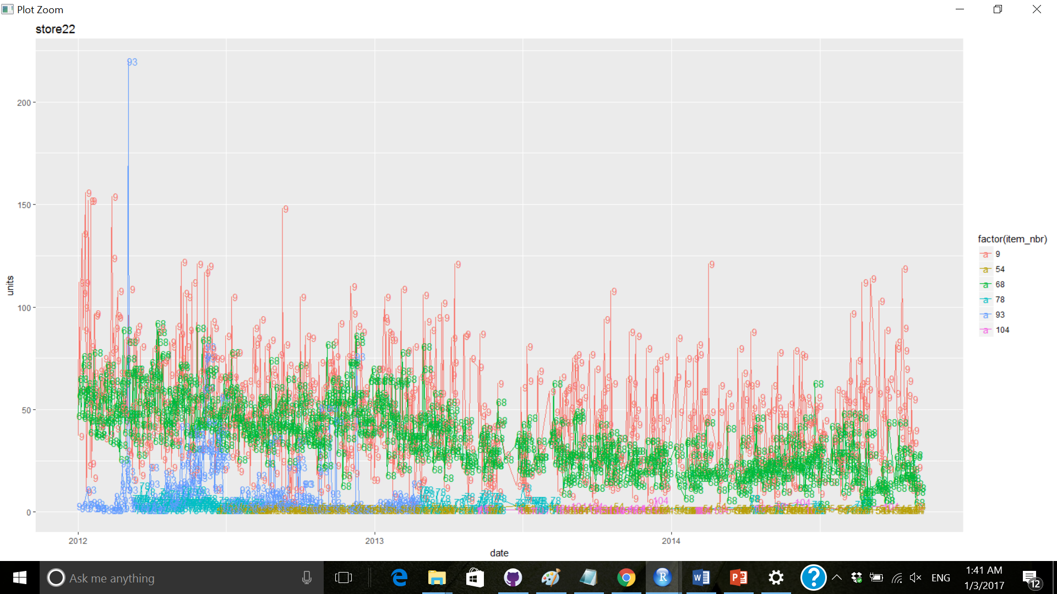
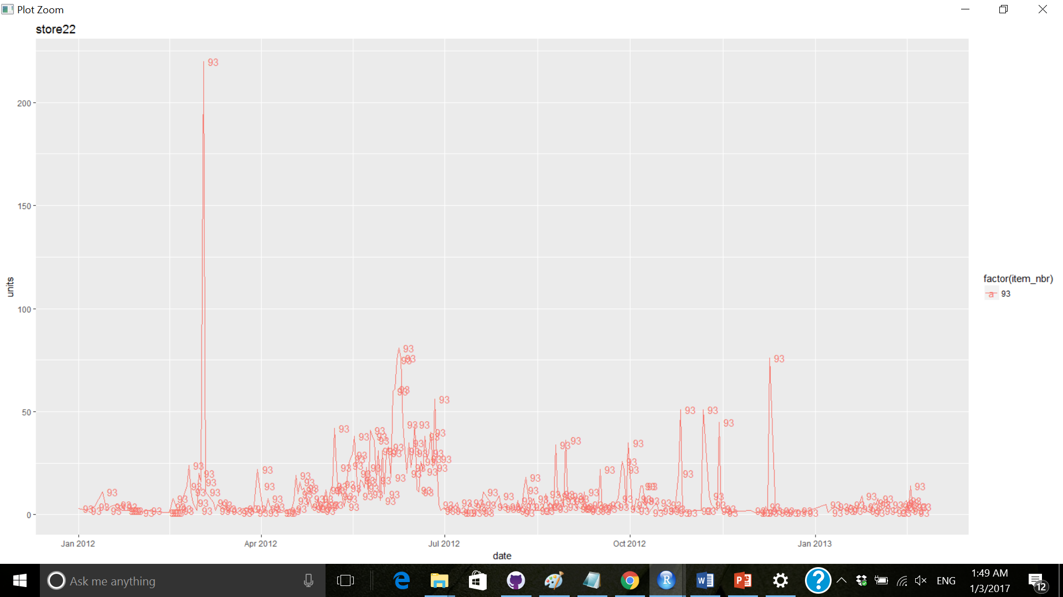
Sales pattern of each item in store – 1 of 3 – Store 22
Qty for item 93 has something wrong
Recommendation – Fix the qty for item 93

Slide 16
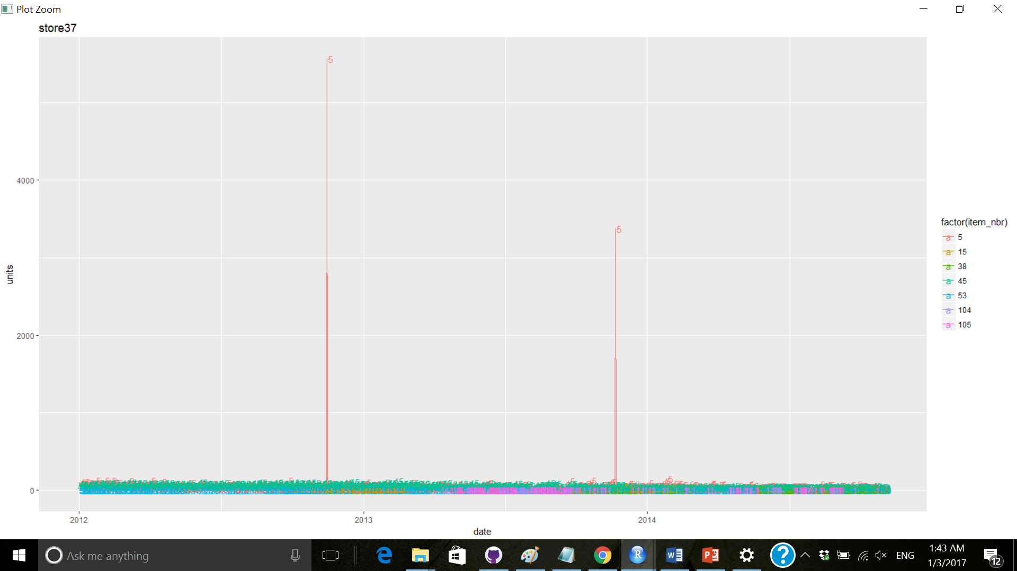
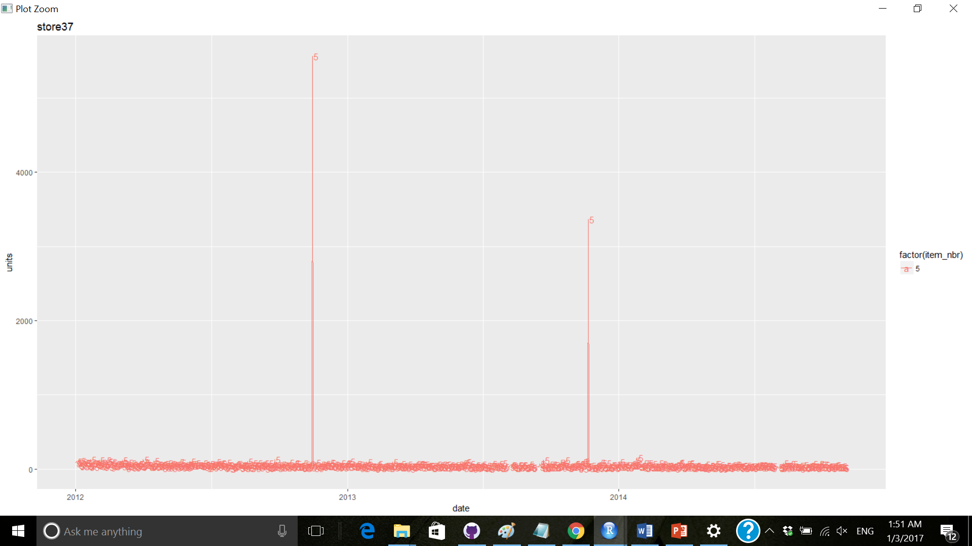
Sales pattern of each item in store – 2 of 3 – Store 37
Qty for item 5 has something wrong
Recommendation – Fix the qty for item 5

Slide 17
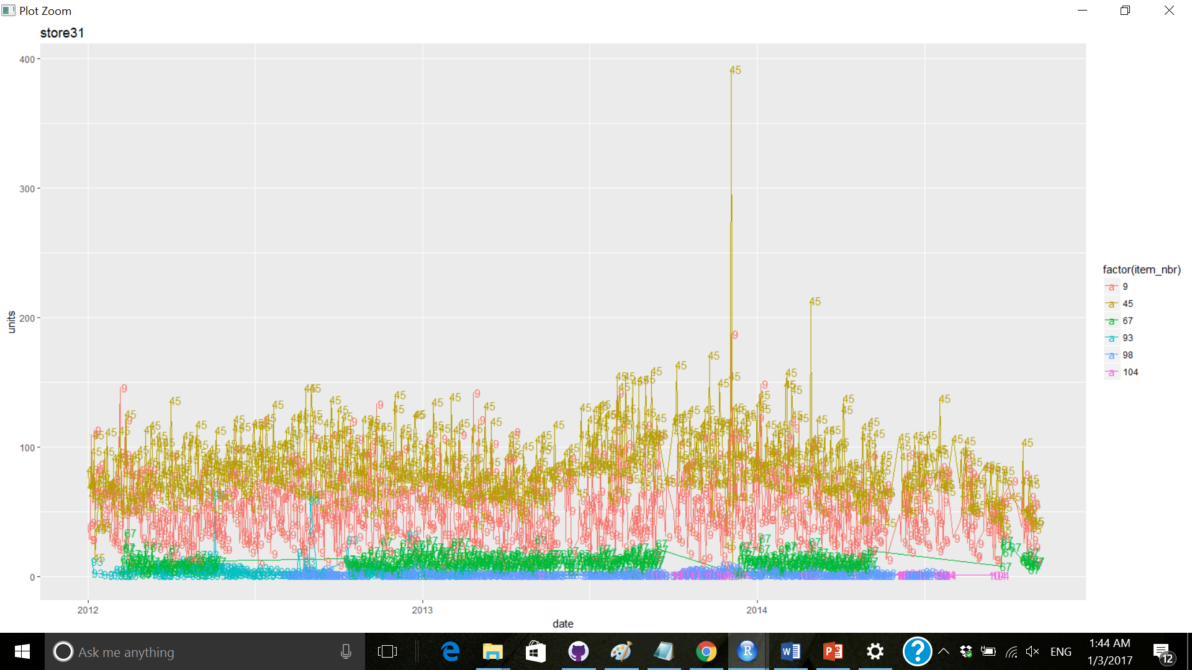
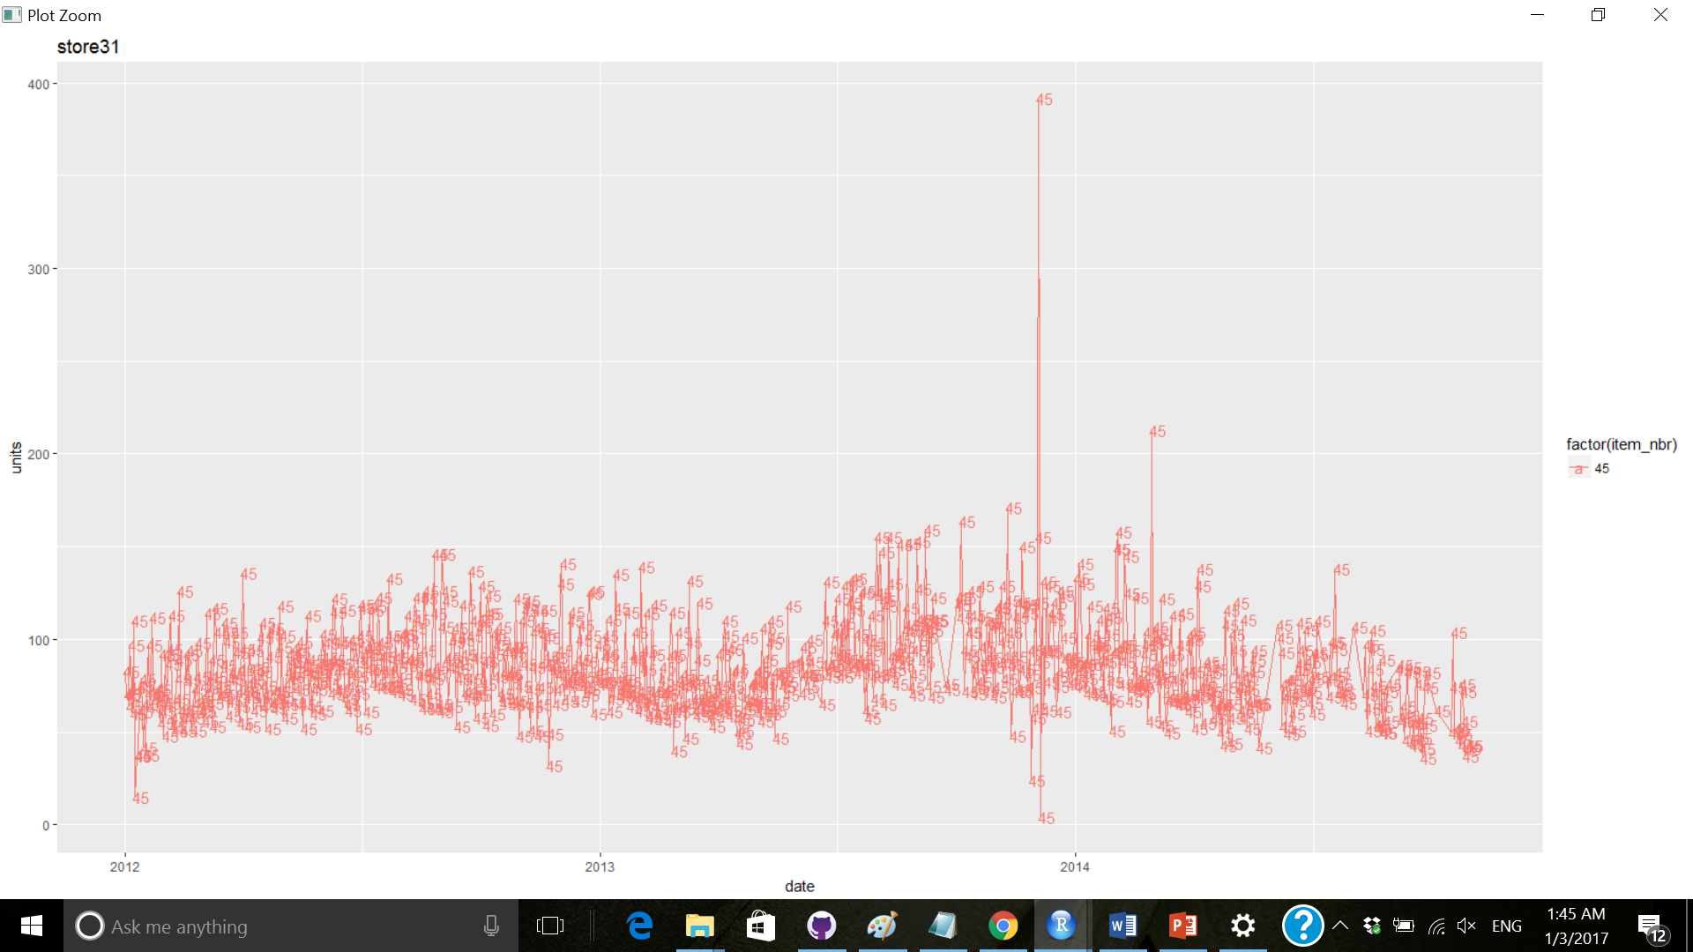
Sales pattern of each item in store – 3 of 3 – Store 31
Recommendation – Review the qty for item 45

Slide 18
Review of Highest selling items

Slide 19
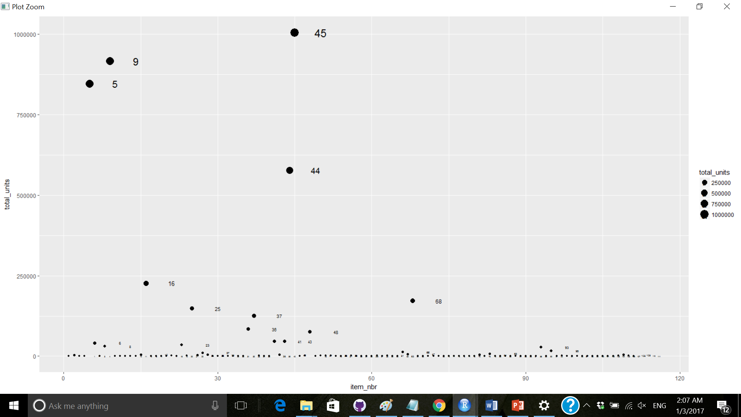
Which items
Recommendation – Review item 45, 9, 5, 44

Slide 20
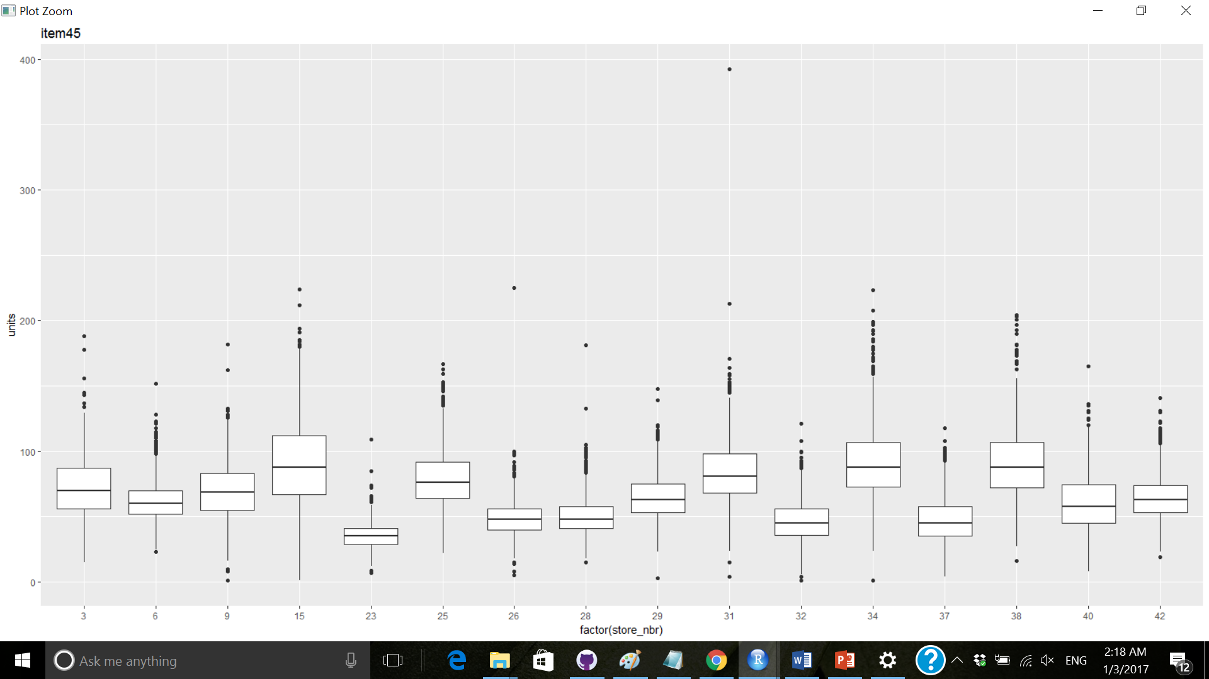
Review of item across all stores
Recommendation – Qty of item 45 at store 31 should be fixed

Slide 21
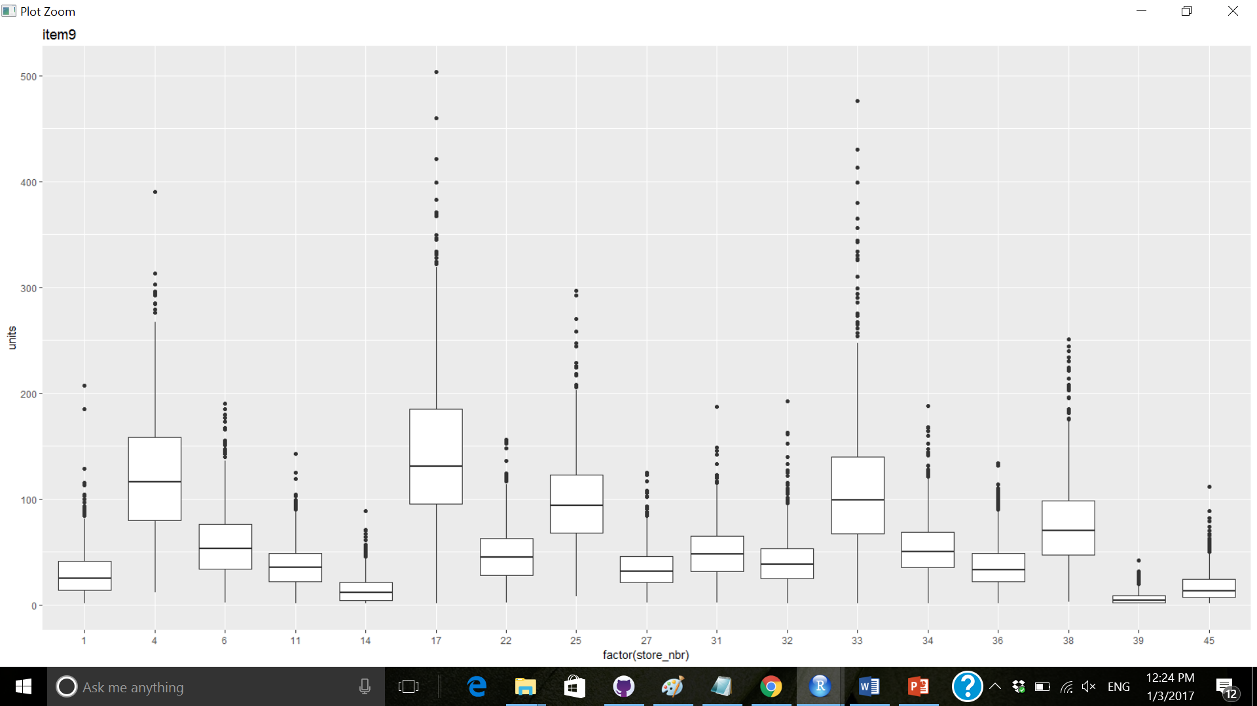
Review of item across all stores
Recommendation – Item 9 does not show any issue

Slide 22
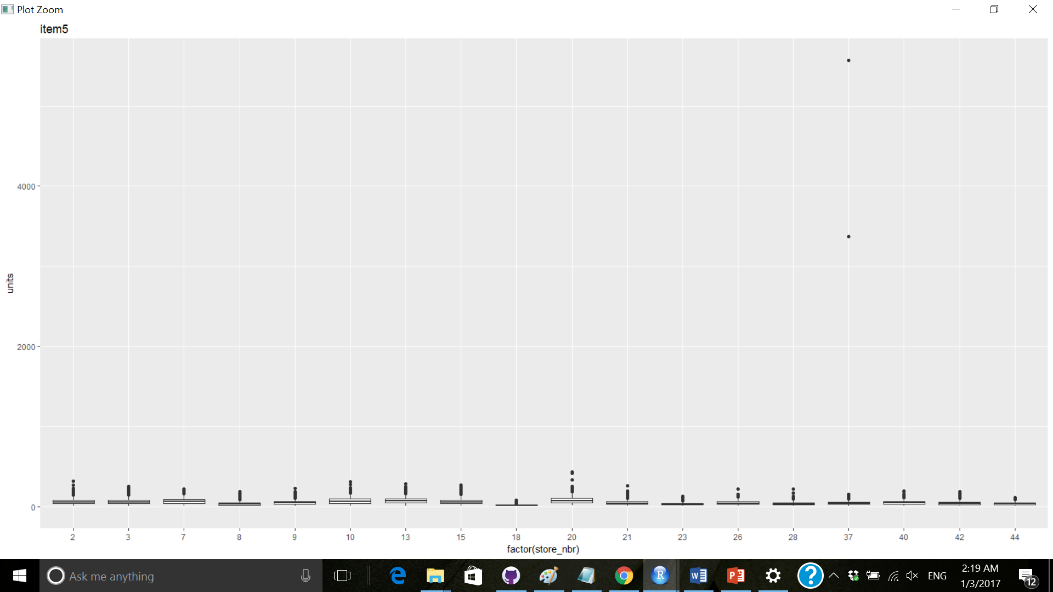
Review of item across all stores
Recommendation – Qty of item 5 at store 37 should be fixed

Slide 23
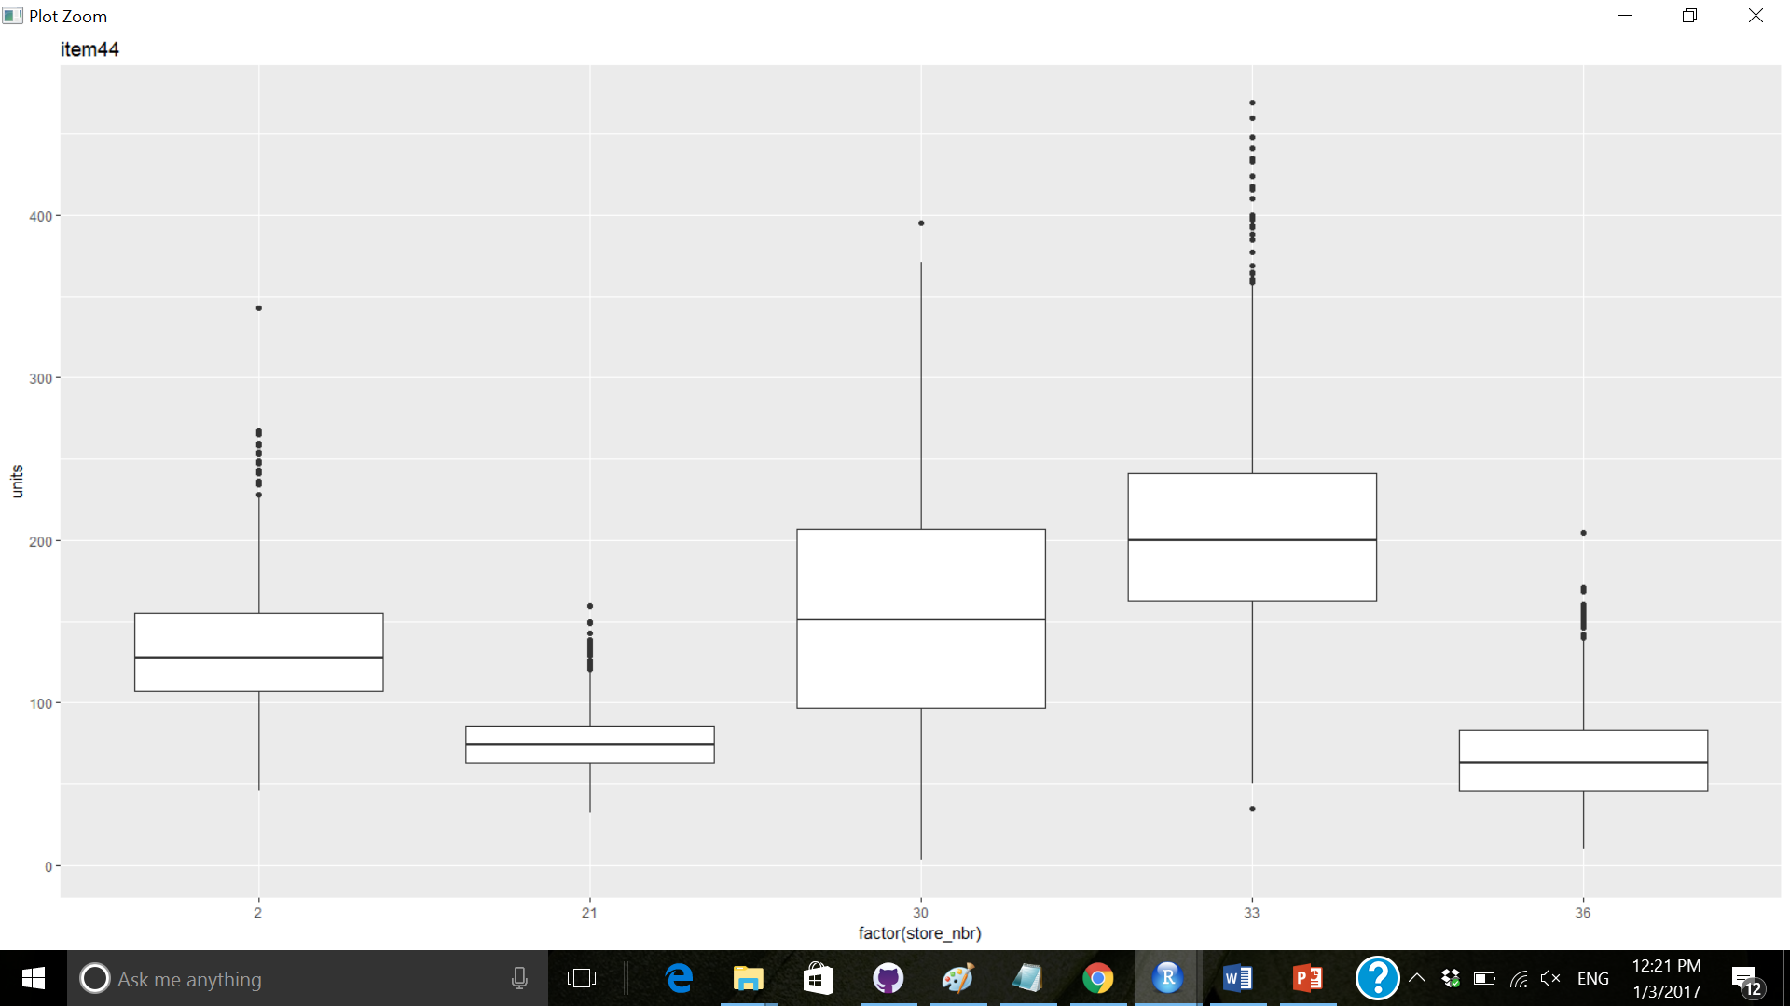
Review of item across all stores
Recommendation – No issue for item 44

Slide 24
Review of EACH ITEM

Slide 25
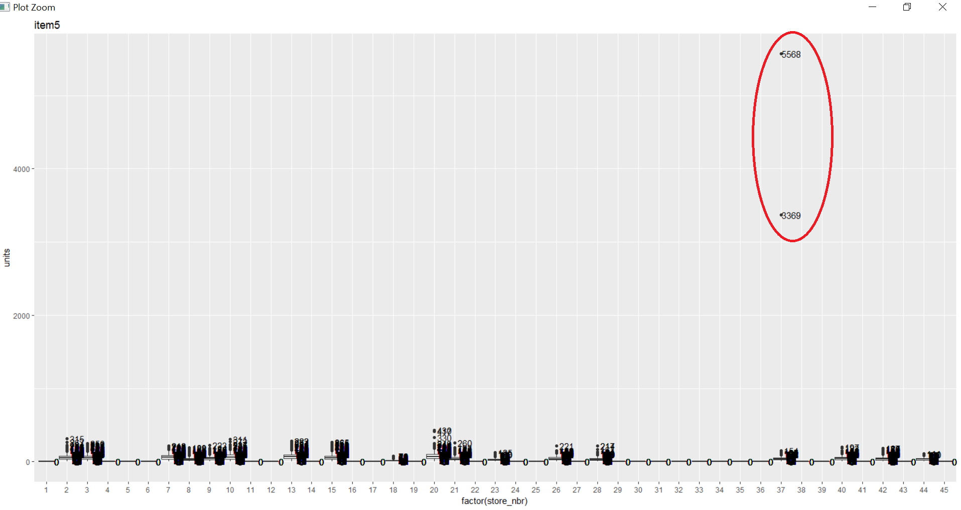
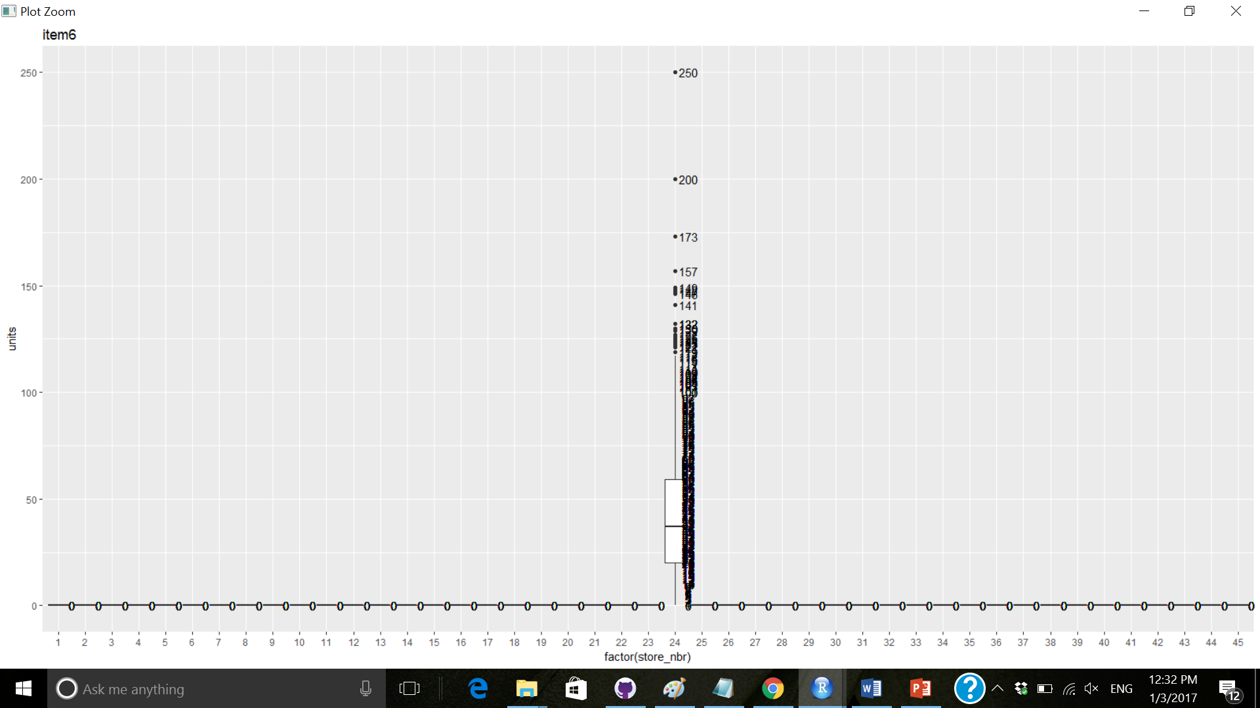
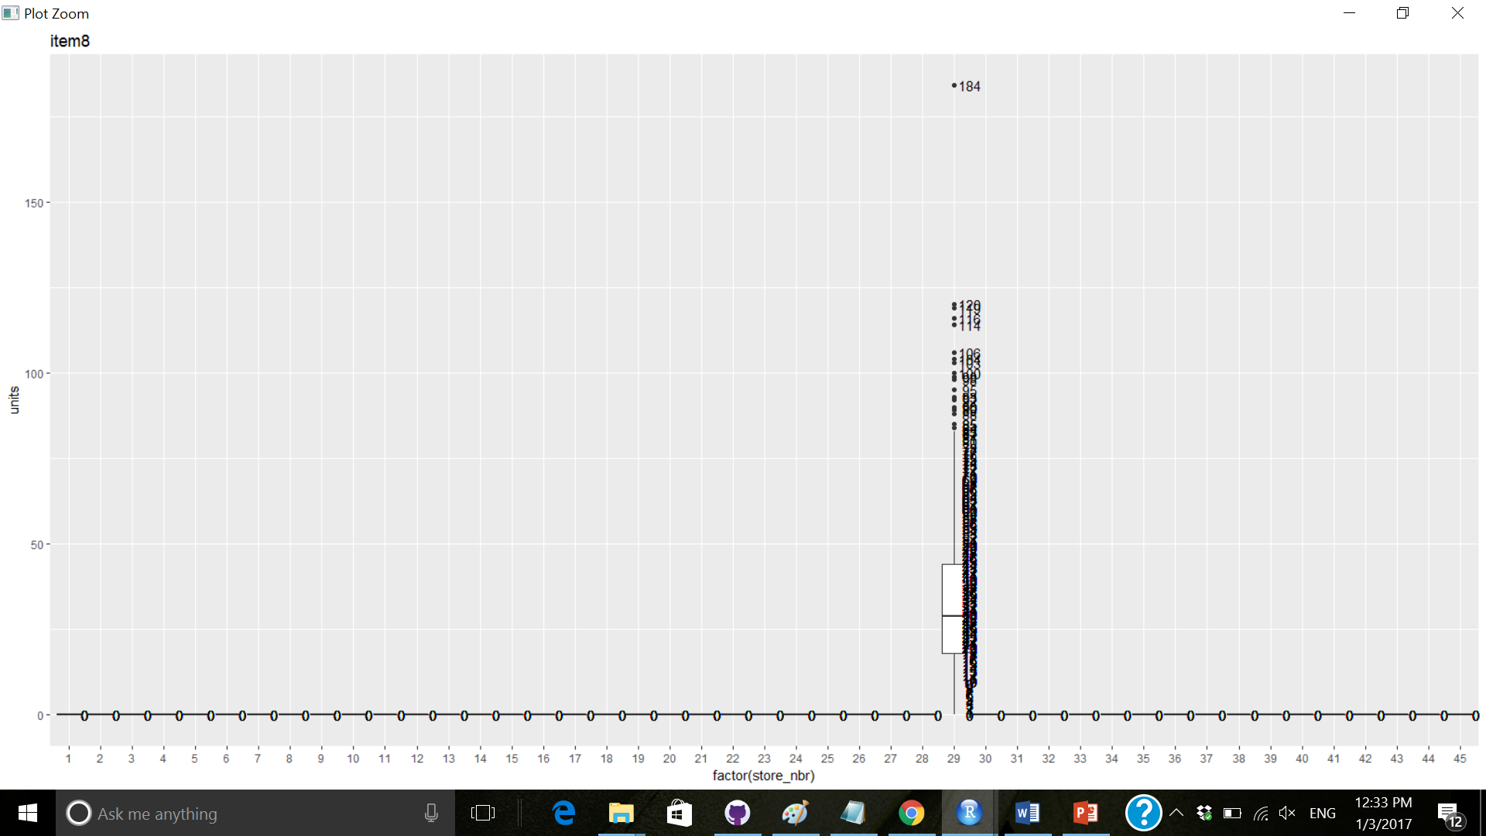
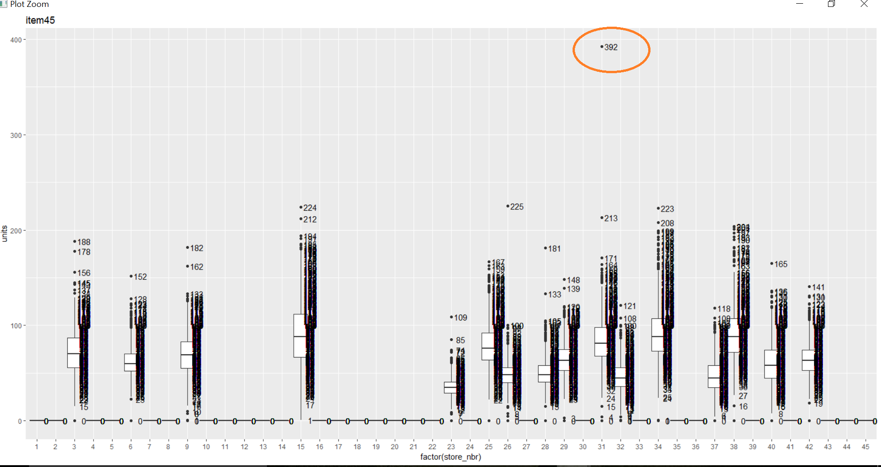
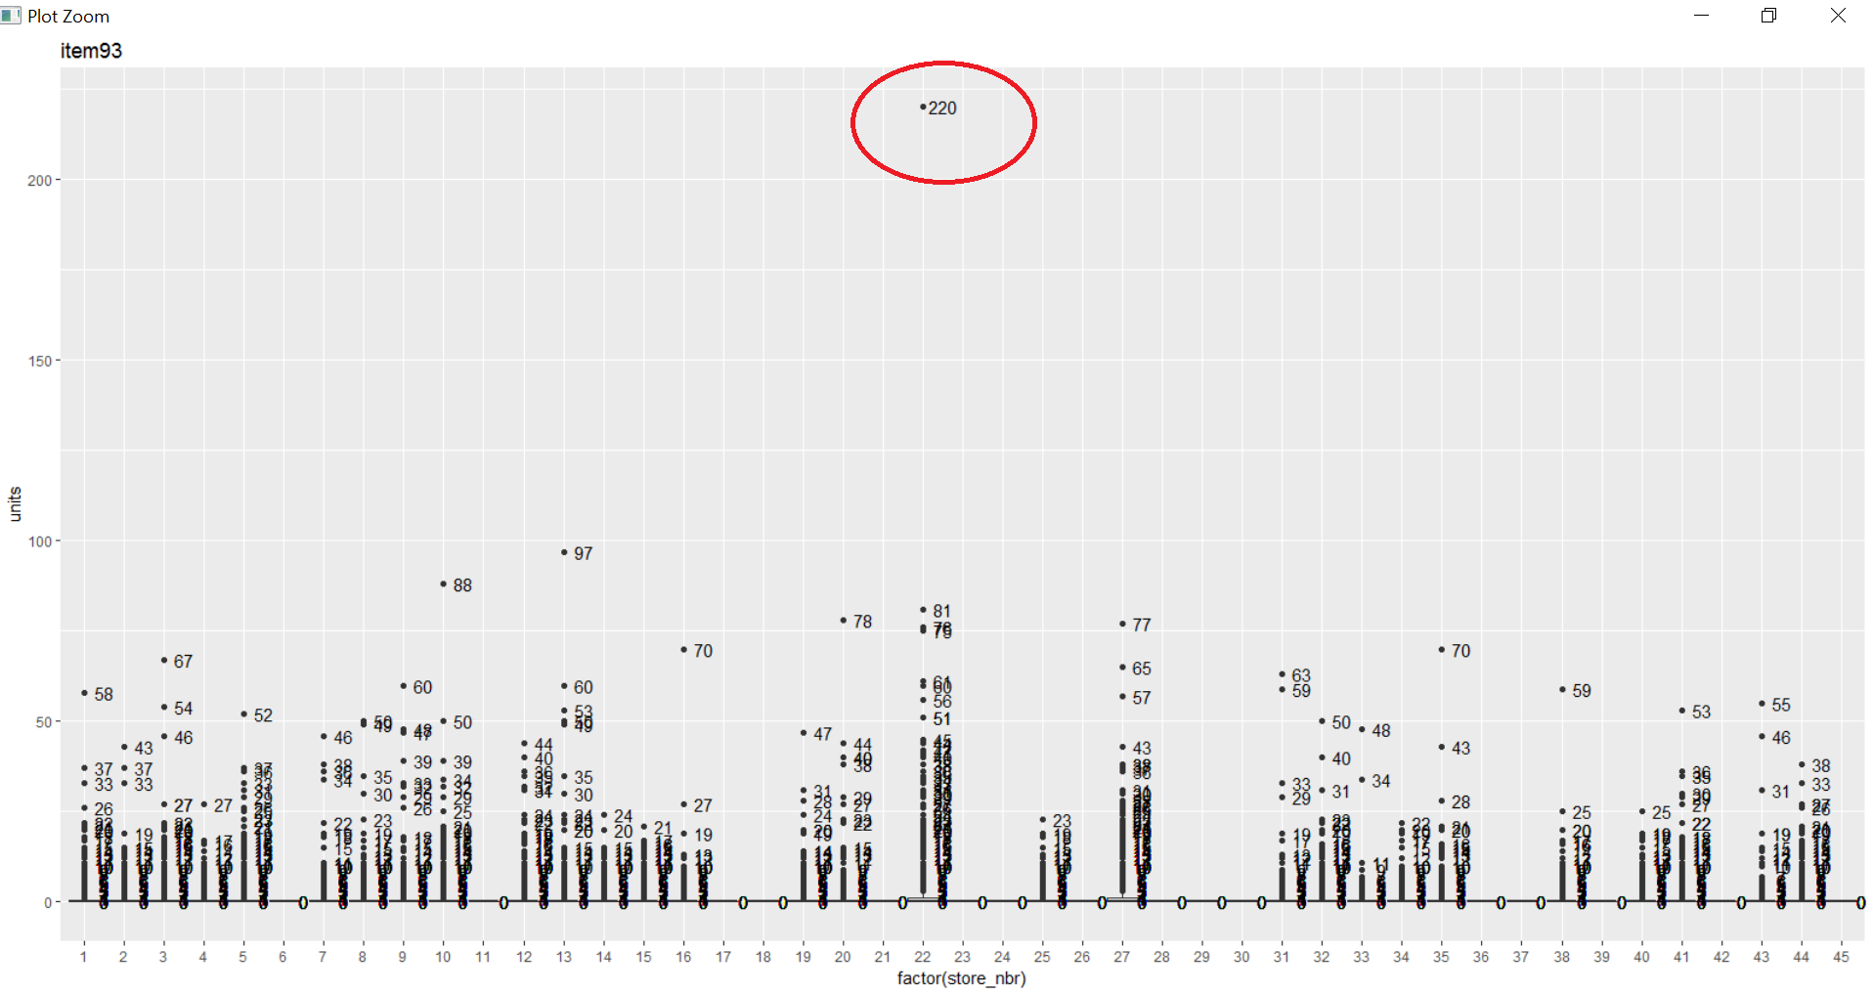
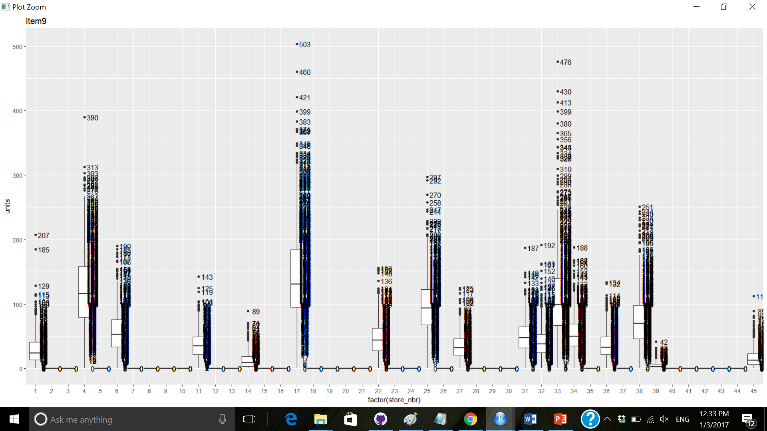
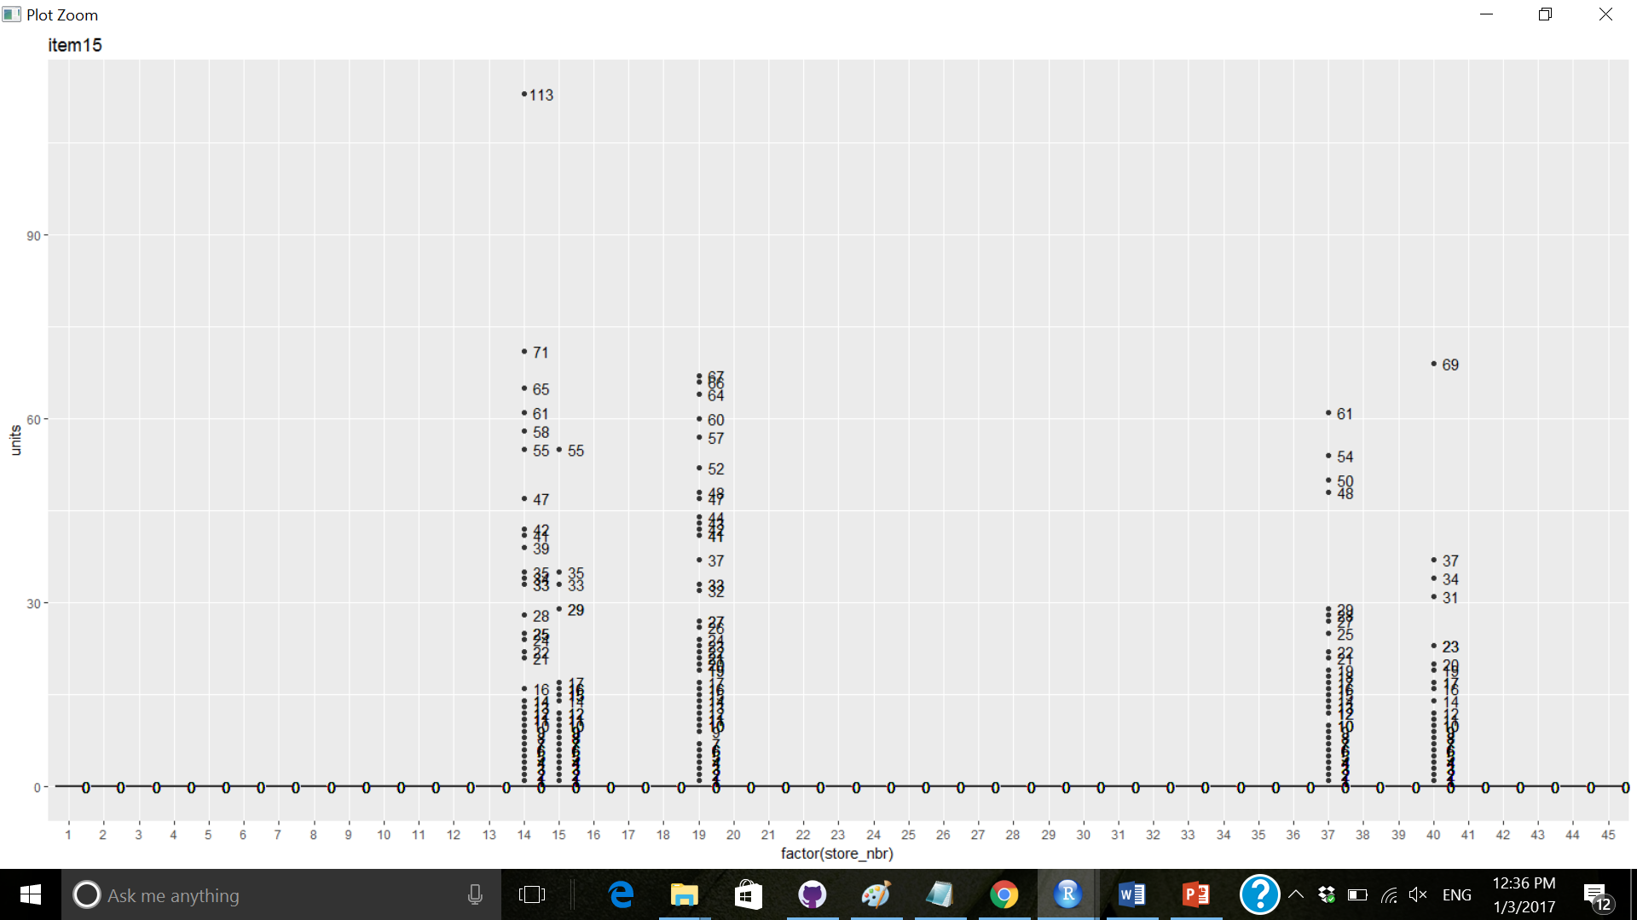
Review of item across all stores
Recommendation – Item # 6,8,9,15, 16,23,25,28….,44,… have huge deviations, but are not outliers. There could be some other driver of lift for them
Recommendation – Fix item # 5 and item # 93
Recommendation – Review item # 45

Slide 26
Final recommendations
Fix item 5 and 93
Keep an eye on item 45
Item # 6,8,9,15, 16,23,25,28….,44,… have huge deviations, but are not outliers. There could be some other driver of lift for them
No impact of holidays or weekday/weekend on sales of these 111 items

Slide 27
Recap - Next steps
1 – If leading average of sold qty for last 7 days is greater than 1 and qty of today is 0 and trailing average of 7 days is greater than 1, item is stock-out
2 – Should I take 50%of training data for model and 50% for validation
Identify stock-outs
Compare weekly sales for 2012, 2013 and 2014 for weekday/weekend
Sales data does not indicate any clustering of stores or items -> Review weather data for station and see if it points to different weather patterns -> If yes, join training and weather data; and cluster stores according to weather
Run regression to predict sales for weather

